Slide 1
Instagram Database
Submitted to faculty Dr. Rajni Aron
[Semester IV: MBA-Tech Data Science]
Presented by
Aaron Mendonca S023
Vedant Ayare S003

Slide 2
Table of Contents
Project Description
Entity – Relationship Diagram
Relational Schema
Querying for information
Conclusions
Works Cited

Slide 3






Project Description : Introduction
Instagram is a digital platform where users can create, share, and interact with content and other users.
Instagram has become an integral part of modern communication, and it has changed the way people connect, communicate, and consume information
Social media platforms allow users to share various types of content, including text, photos, videos, and links. Users can also engage with other users by liking, commenting, sharing, and following their content.

Slide 4
Objectives
To Create a basic structure of social media database which could easily be connected to frontend interface.
To manage data of multiple users, their followers, interests and public activity on the social media platform which includes post likes, comments, hashtags many more...
To show a clear cut description of connection and inter relation between entities using ER and Relational Schema Diagrams
To fetch and store data in its true form, img/url etc

Slide 5
Advantages
Comprehensive data analysis: SQL queries can help to analyze Instagram data comprehensively, including user behavior, preferences, engagement rates, and reach. This analysis can provide valuable insights to businesses, organizations, and individuals to make informed decisions.
Better decision-making: Analyzing Instagram data can help businesses and organizations to make data-driven decisions that are based on evidence and not just assumptions. This can lead to better-targeted marketing strategies and improved customer engagement.
Competitive advantage: Instagram data can help businesses to identify trends and patterns before their competitors, giving them a competitive advantage in the marketplace.
Scalability: An Instagram database project in SQL can be easily scaled up or down based on the volume of data being collected and analyzed. This makes it a flexible solution that can adapt to changing business needs.

Slide 6
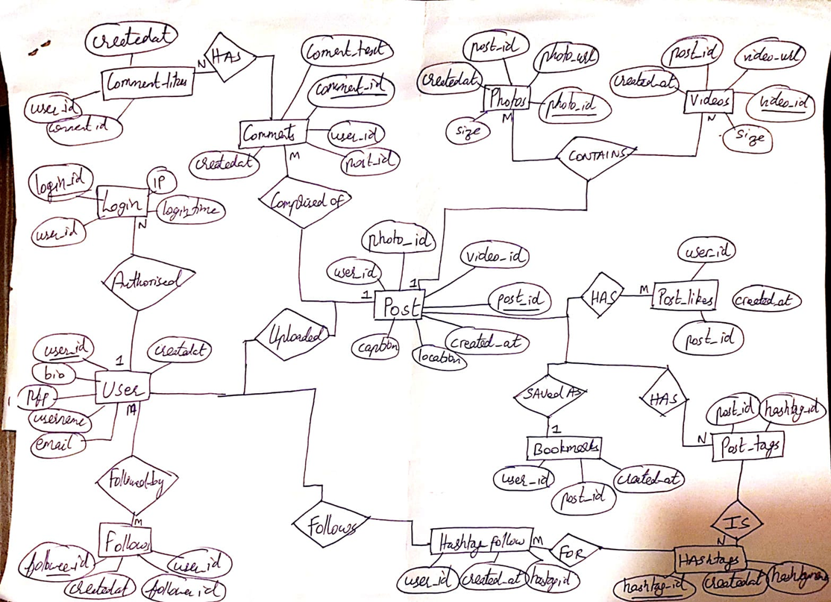
Entity Relationship Diagram

Slide 7
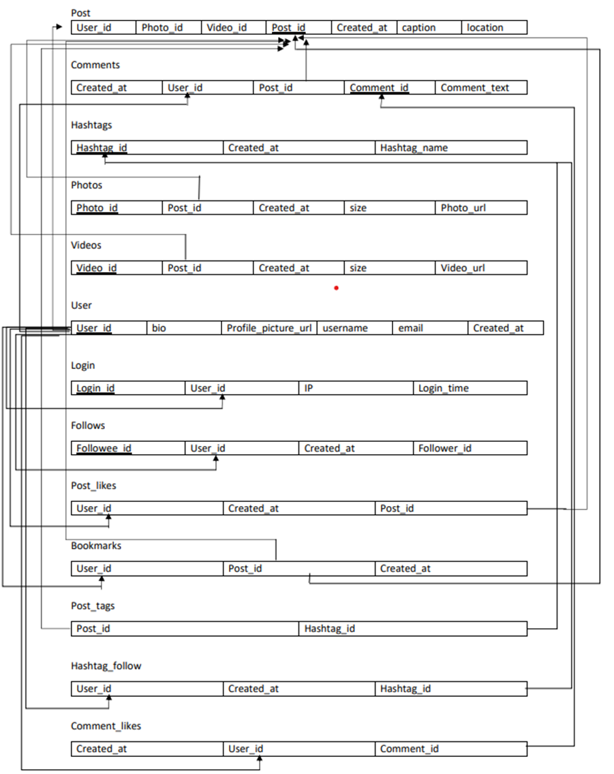

Relational Schema

Slide 8
Assumptions about the Database
Each user has a unique username and email.
Each user can have a profile photo, bio and multiple posts associated with their account.
Each post can have either a photo, a video or both.
Each post can have multiple comments and likes from users.
Users can follow and be followed by other users.
Users can follow multiple hashtags and a hashtag can be followed by multiple users.
Each post can have multiple hashtags associated with it.
Users can bookmark posts for future reference.
User login details are stored in a separate table for security purposes.

Slide 9
Assumptions about the Normal Forms (NF)
The database schema satisfies the requirements of First Normal Form (1NF) since all tables have a primary key and each attribute has a single value.
The database schema satisfies the requirements of Second Normal Form (2NF) since all non-key attributes are dependent on the primary key.
The database schema satisfies the requirements of Third Normal Form (3NF) since there are no transitive dependencies between non-key attributes.

Slide 10
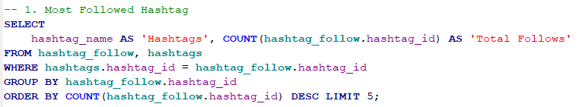
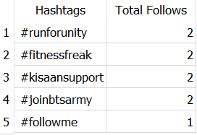
Most Followed Hashtag

Slide 11
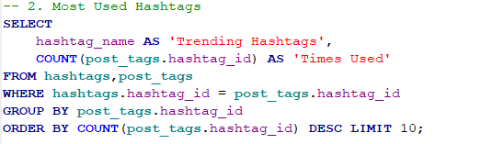
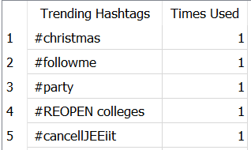
Most Used Hashtag

Slide 12


Most Inactive User

Slide 13
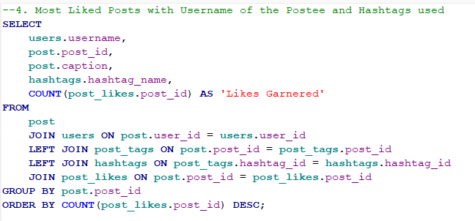
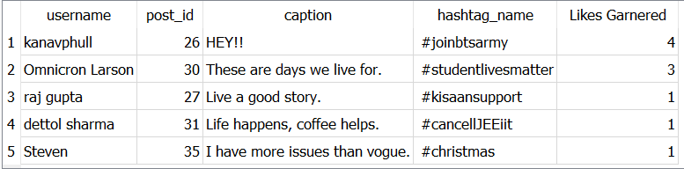
Most Liked Posts with Username and Hashtags used

Slide 14

Average Posts per User

Slide 15
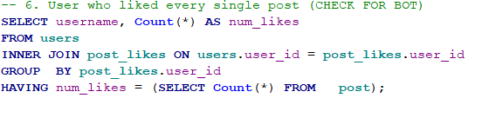

Users who have liked every single post

Slide 16

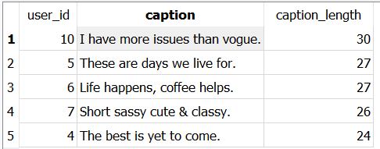
Post with Longest Caption

Slide 17

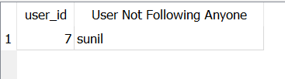
Users not following anyone

Slide 18


Searching for specific words in comments

Slide 19
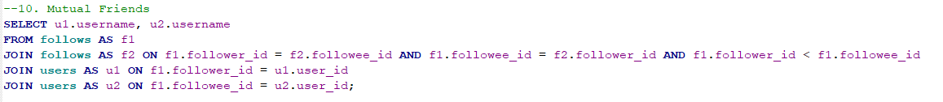
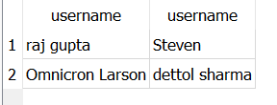
Mutual Friends

Slide 20
Conclusions
Our database design ensured data integrity and consistency by implementing appropriate constraints and relationships between tables.
We have also incorporated features to prevent data duplication and ensure accuracy, such as unique keys and foreign keys.
We successfully created ER and Relational Schema diagrams to better understand the structure and complexity of our database
We maintained the true essence of our data.

Slide 21

